Slide 1

PREDICTING YOUTH DRUG USE
USING NSDUH DATA TO UNDERSTAND AND PREDICT YOUTH BEHAVIOR
By Ankit Bisleri

Slide 2

INTRODUCTION
Goal: Predict marijuana use and behavior patterns among youth.
Tasks:
Binary Classification: Predict ever used marijuana (MRJFLAG).
Multiclass Classification: Predict usage frequency (MRJYDAYS).
Regression: Predict age of first marijuana use (IRMJAGE).
Dataset: NSDUH 2020 Youth Data (30,000+ records).
Challenges: Handling special missing codes (991, 993), severe class imbalance.

Slide 3
THEORETICAL BACKGROUND
Decision Trees: Predict outcomes by splitting features into decision rules; easy to interpret but prone to overfitting.
Random Forests: Ensemble of decision trees; reduces overfitting by averaging many trees; improves stability and accuracy.
Gradient Boosting: Builds trees sequentially to correct prior mistakes; uses shrinkage (learning rate) to avoid overfitting; typically achieves higher accuracy but needs careful tuning.
SMOTE (for Multiclass Only):Synthetic Minority Oversampling Technique used to balance severely imbalanced classes.
Bagging (Bootstrap Aggregating):Trains multiple models on random subsets of data and averages their predictions to reduce variance and prevent overfitting.

Slide 4
DATA PREPARATION
Replaced special missing codes (991, 993, 91, 93) with appropriate values or NA.
Converted parental presence (IMOTHER, IFATHER) to binary indicators.
Selected key features: Demographic, School, Parental Factors.
Applied SMOTE oversampling only for Multiclass task.
Train/Test Split: 70% training, 30% testing.

Slide 5
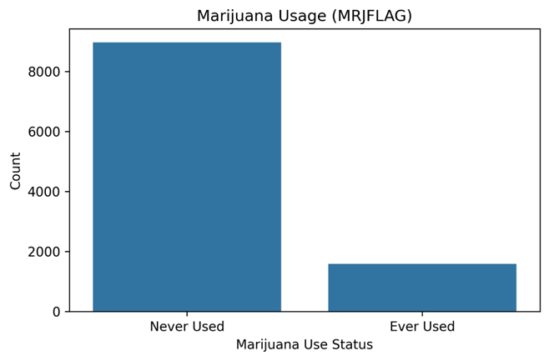
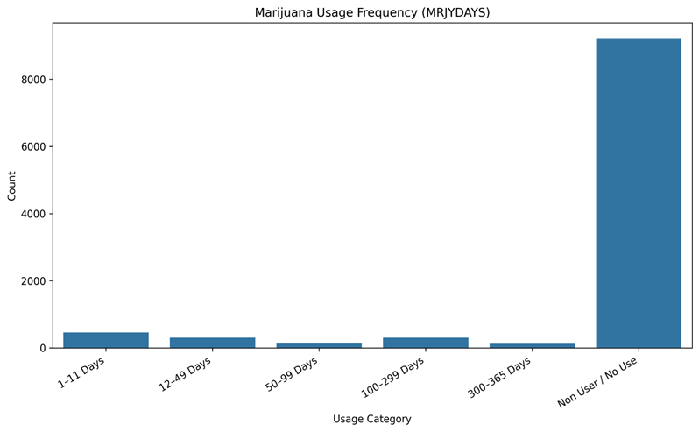
EDA CLASSIFICATION TARGETS
MRJFLAG (Binary Target):
85% never used; 15% used.
MRJYDAYS(Usage Frequency in Past Year):
Majority report daily use; very few lower usage categories.

Slide 6
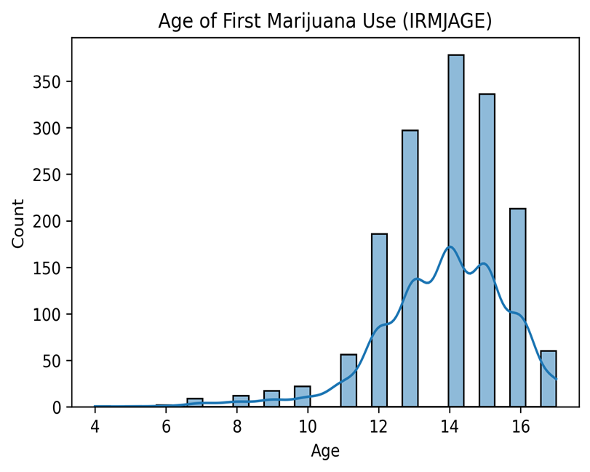
EDA REGRESSION TARGET
IRMJAGE (Age at First Use):
Most youth first try marijuana between ages 15–17.
Few users start after age 25.

Slide 7
BINARY CLASSIFICATION: PREDICTING MARIJUANA USE
Target: MRJFLAG (0 = Never used, 1 = Ever used).
Features Used:
Demographic: Gender, Race, Family Income, Health.
School Factors: School Attendance, Grade.
Parental Factors: Homework Help, Chores, Parental Supervision.
Models Trained:
Decision Tree Classifier
Random Forest Classifier
Handling Class Imbalance:
Class weighting used (class_weight=balanced) in models.

Slide 8
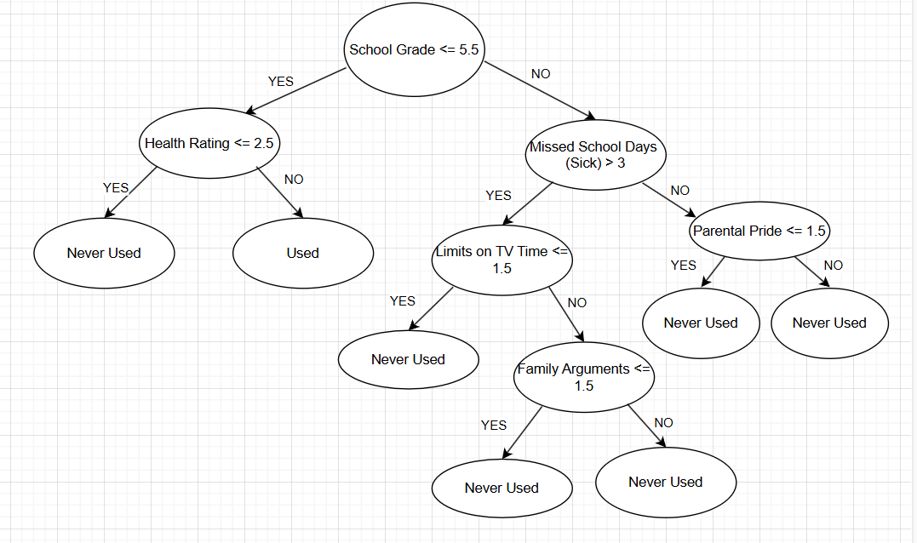
PRUNED TREE
Jordan:
• School Grade = 6
• Missed School Days = 4
• TV Limits = 2
• Family Arguments = 1
Prediction:
Never Used Marijuana

Slide 9
BINARY CLASSIFICATION RESULTS & COMPARISON
Model | Accuracy | Precision (Class 1) | Recall (Class 1) | F1-Score (Class 1) | Comments
Unpruned Decision Tree | 76.7% | 0.23 | 0.26 | 0.24 | Slightly Overfitting
Pruned Decision Tree | 85.4% | 0.00 | 0.00 | 0.00 | Improved accuracy but fails for minority class
Random Forest | 83.6% | 0.28 | 0.08 | 0.12 | Handles majority class very well
Random Forest (Balanced) | 83.6% | 0.28 | 0.08 | 0.12 | Same as RF, reweighted classes but minimal change
Pruning improved overall accuracy compared to Unpruned Tree.
Random Forest provided more stable performance but struggled with minority class (MRJFLAG=1).
Class imbalance remains a major challenge even after balancing weights.
Important Predictors: School Grade, Missed School Days, Race/Ethnicity.

Slide 10
MULTICLASS CLASSIFICATION: PREDICTING USAGE FREQUENCY
Target: MRJYDAYS (Usage Frequency in Past Year, 6 classes).
Classes:
1 = 1–2 days
2 = 3–5 days
3 = 6–19 days
4 = 20–39 days
5 = 40–99 days
6 = 100–365 days (Daily Use)
Challenges:
Severe class imbalance (83% in Class 6).
Models Trained:
Decision Tree and Random Forest Classifier
SMOTE:
Applied to training data to balance classes.

Slide 11
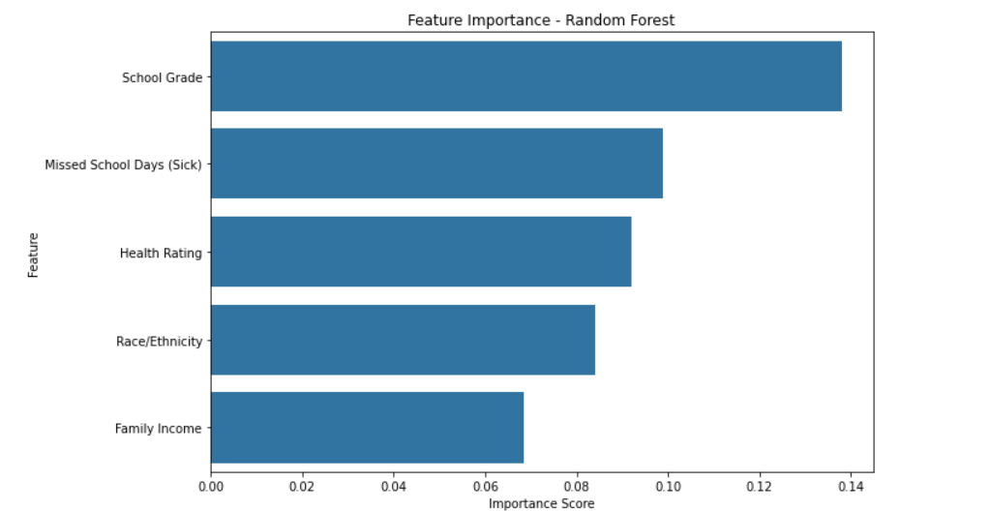
MULTICLASS CLASSIFICATION: PREDICTING USAGE FREQUENCY
School Grade was the most important predictor of marijuana use.
Missed School Days (Sick) and Health Rating also strongly influenced the prediction.
Race/Ethnicity and Family Income had moderate impact.
Academic performance and health-related behavior were more predictive than family income or demographics alone.

Slide 12
MULTICLASS CLASSIFICATION RESULTS & COMPARISON
Model | Accuracy | Macro Avg. Precision | Macro Avg. Recall | Comments
Unpruned Decision Tree | 79.99% | 0.21 | 0.23 | Bias toward majority class; poor minority class recall.
Pruned Decision Tree | 44.10% | 0.20 | 0.25 | Simplified model; slight improvement for rare classes.
Random Forest | 87.30% | 0.16 | 0.17 | High overall accuracy but ignores minority classes.
Random Forest (Balanced) | 86.80% | 0.19 | 0.17 | Minor recall improvement for rare classes; slight accuracy drop.
Without SMOTE, Random Forest achieved very high accuracy (~87%) but was dominated by Class 6.
After applying SMOTE, minority class recall improved slightly, though overall accuracy dropped very slightly (~0.5%).
Decision Tree models showed very poor performance for minority classes without resampling.

Slide 13
REGRESSION TASK: PREDICTING AGE OF FIRST MARIJUANA USE
Target :IRMJAGE (Age of First Marijuana Use)
Models Trained:
Decision Tree Regressor
Random Forest Regressor
Gradient Boosting Regressor
Data Preparation:
Removed non-users (IRMJAGE=991)
Imputed missing demographic, school, parental features
Goal: Predict age of first use accurately with minimum RMSE.

Slide 14
REGRESSION RESULTS & COMPARISON
Model | RMSE | MAE | Comments
Decision Tree Regressor | 2.04 | 1.50 | High error, overfitting likely, poor generalization.
Random Forest Regressor (Default) | 1.53 | 1.14 | Better than Decision Tree, but not tuned yet.
Random Forest Regressor (Tuned) | 1.53 | 1.13 | Slight improvement with tuning (max_depth=10, max_features='sqrt').
Gradient Boosting Regressor (Tuned) | 1.47 | 1.10 | Best performance; benefited from learning rate 0.01 (shrinkage)
Gradient Boosting achieved the lowest RMSE (~1.47 years), meaning most accurate age prediction.
Tuned Random Forest performed better than default Random Forest.
Decision Tree Regressor had the highest error, confirming instability without ensemble methods.
Hyperparameter tuning and shrinkage were critical for improving model performance.

Slide 15
ETHICAL CONSIDERATIONS
Bias Awareness:
Predictive models may reflect and reinforce existing societal biases present in survey data.
Youth Sensitivity:
Predicting substance use among youth requires extra caution to avoid stigmatization or misuse of predictions.
Fairness Across Groups:
Models showed imbalance issues — heavier users were easier to predict than rare users, suggesting fairness challenges.
Data Privacy and Integrity:
NSDUH data was anonymized; no personally identifiable information was used or exposed.

Slide 16
DISCUSSIONS
Binary Classification:
Pruned Decision Tree and Random Forest achieved ~84–85% accuracy.
Multiclass Classification:
Random Forest (with SMOTE) achieved ~86–87% accuracy; slight improvement in minority class recall.
Regression Prediction:
Gradient Boosting Regressor performed best with RMSE ~1.47 years.
Impact of Tuning:
Hyperparameter tuning (max_depth, max_features, shrinkage) significantly improved Random Forest and Gradient Boosting models.
Key Learnings:
Handling class imbalance, avoiding overfitting, and ethical modeling practices are critical when predicting sensitive youth behaviors.

Slide 17
CONCLUSIONS
Machine learning can identify at-risk youth by analyzing school, family, and demographic factors.
Models like Random Forest and Gradient Boosting support early intervention and targeted prevention.
These insights can guide schools, counselors, and public health programs in resource allocation.
Predictive tools act as early warning systems — aiding professionals, not replacing them.

Slide 18
THANK YOU

